Slide 1
Encryption in mongodb
Anju munoth

Slide 2
MongoDB Data Encryption
MongoDB offers robust encryption features to protect data while in-transit, at-rest, and in-use — providing encryption of your data through its full lifecycle.

Slide 3
Encryption in-transit
MongoDB Enterprise Advanced supports encryption in-transit using Transport Layer Security (TLS).
In Atlas, all network traffic to MongoDB clusters is protected by TLS by default.
TLS cannot be disabled and the default version is TLS v1.2.
Data that is transmitted to MongoDB clusters, as well as data transmitted between nodes of your MongoDB clusters, is encrypted in-transit using TLS.

Slide 4
Encryption at-rest
Encryption at-rest is a database-level protection layer to guarantee that the written files and data are encrypted while stored.
MongoDB Enterprise Advanced (EA) has implemented the at-rest encryption in WiredTiger, the database storage engine.
The default at-rest encryption that WiredTiger uses is AES-256 via OpenSSL.
Can configure at-rest encryption in MongoDB EA with a KMIP-enabled key provider.

Slide 5
In-Use Encryption
Data is encrypted client-side with customer-controlled encryption keys, before being sent, stored, or retrieved from the database.
Benefits :
Data encrypted throughout its lifecycle The strongest technical control to ensure that data always remains encrypted in-use, in backups, at-rest, and in-transit.
Faster application development cycle MongoDB takes the complexity out of developing applications for sensitive workloads.
Developers don’t have to be security or cryptography experts to build encryption into their applications.
Enables critical data privacy use cases
Allow customers to meet strict data privacy requirements for confidentiality using standards-based cryptography.

Slide 6
In-Use Encryption
MongoDB has two features for encryption in-use to meet your data protection needs.
Client-Side Field Level Encryption
Queryable Encryption (Preview in 6.0)

Slide 7
Client-Side Field Level Encryption
Client-Side Field Level Encryption (FLE) is an in-use encryption capability that enables a client application to encrypt sensitive data before storing it in the MongoDB database.
Sensitive data is transparently encrypted, remains encrypted throughout its lifecycle, and is only decrypted on the client side.

Slide 8
Client-Side Field Level Encryption
Enables you to encrypt data in your application before you send it over the network to MongoDB.
With CSFLE enabled, no MongoDB product has access to your data in an unencrypted form.
Can set up CSFLE using the following mechanisms:
Automatic Encryption: Enables you to perform encrypted read and write operations without you having to write code to specify how to encrypt fields.
Explicit Encryption: Enables you to perform encrypted read and write operations through your MongoDB driver's encryption library.
You must specify the logic for encryption with this library throughout your application.

Slide 9
Queryable Encryption (Preview in 6.0)
Queryable Encryption, now in Preview in 6.0, is an in-use encryption capability that enables an application to encrypt sensitive data from the client-side, store the encrypted data in the MongoDB database, and run expressive queries on the encrypted data using an industry-first searchable encryption scheme.
Data can be queried using equality matches (in Preview) with range, prefix, suffix, and substring query capabilities planned.

Slide 10
Encrypt Communication
Configure MongoDB to use TLS/SSL for all incoming and outgoing connections.
Use TLS/SSL to encrypt communication between mongod and mongos components of a MongoDB deployment as well as between all applications and MongoDB.
MongoDB uses the native TLS/SSL OS libraries:
Platform | TLS/SSL Library
Windows | Secure Channel (Schannel)
Linux/BSD | OpenSSL
macOS | Secure Transport

Slide 11
Encrypt and Protect Data
Starting with MongoDB Enterprise 3.2, the WiredTiger storage engine’s native Encryption at Rest can be configured to encrypt data in the storage layer.
If you are not using WiredTiger’s encryption at rest, MongoDB data should be encrypted on each host using file-system, device, or physical encryption.
Protect MongoDB data using file-system permissions.
MongoDB data includes data files, configuration files, auditing logs, and key files.

Slide 12
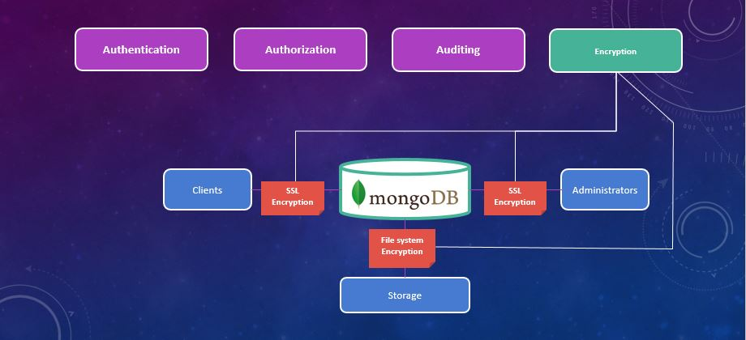

Slide 13
Encryption type
Transport Encryption - refers to encrypting information over network traffic between the client and the server
Encryption at rest - encrypting the data that we store on disk

Slide 14
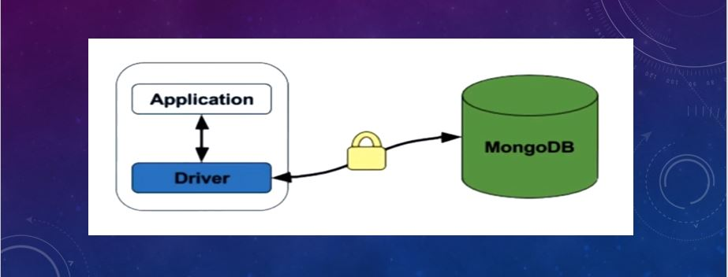
Transport Encryption
Transport encryption, as the name implies, refers to encrypting information over network traffic between the client and the server.

Slide 15
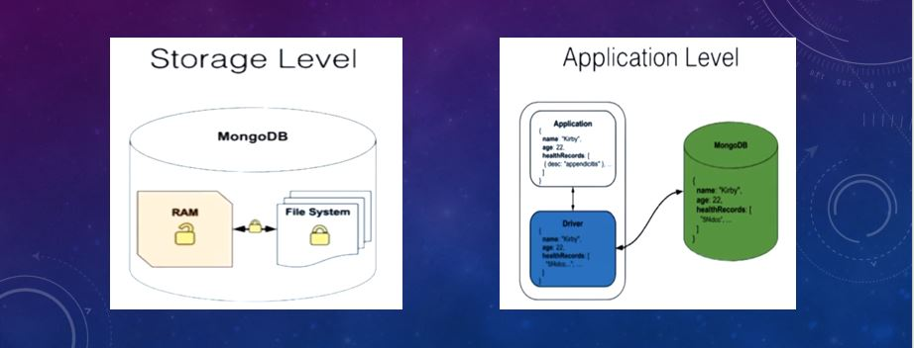

Slide 16
Encrypting Data in Transit
Data is transacted between MongoDB and the server application in two ways that is, through Transport Layer Security (TLS) and Secure Socket Layer (SSL).
Two are the most used encryption protocols for securing sent and received data between two systems.
Encrypt connections to the mongod and mongos instances such that the network traffic is only readable by the intended client.
TLS/SSL are used in MongoDB with some certificates as PEM files which are issued by the certificate authority or can be a self-signed certificate.
The latter has a limitation in that however the communication channel is encrypted, there is always no validation against the server identity hence vulnerable to external attacks midway.
Advisable to use trusted authority certificates which permit MongoDB drivers to also verify the server identity.
Besides encryption, TLS/SSL can be used in the authentication of the client and internal auths of members of replica sets and sharded clusters through the certificates.

Slide 17
TLS/SSL (Transport Encryption)
MongoDB supports TLS/SSL (Transport Layer Security/Secure Sockets Layer) to encrypt all of MongoDB's network traffic.
TLS/SSL ensures that MongoDB network traffic is only readable by the intended client.
MongoDB's TLS/SSL encryption only allows use of strong TLS/SSL ciphers with a minimum of 128-bit key length for all connections.
In addition to encrypting connections, TLS/SSL allows for authentication using certificates, both for client authentication and for internal authentication of members of replica sets and sharded clusters.

Slide 18
Certificates
To use TLS/SSL with MongoDB , must have the TLS/SSL certificates as PEM files, which are concatenated certificate containers.
MongoDB can use any valid TLS/SSL certificate issued by a certificate authority or a self-signed certificate.
For production use, your MongoDB deployment should use valid certificates generated and signed by the same certificate authority.
Can generate and maintain an independent certificate authority, or use certificates generated by a third-party TLS/SSL vendor.
Using a certificate signed by a trusted certificate authority allows MongoDB drivers to verify the server's identity.

Slide 19
MongoDB and native TLS/SSL OS libraries:
Platform | TLS/SSL Library
Windows | Secure Channel (Schannel)
Linux/BSD | OpenSSL
macOS | Secure Transport

Slide 20
mongod and mongos Certificate Key File
When establishing a TLS/SSL connection, the mongod / mongos presents a certificate key file to its clients to establish its identity.
Certificate key file contains a public key certificate and its associated private key, but only the public component is revealed to the client.
MongoDB can use any valid TLS/SSL certificate issued by a certificate authority, or a self-signed certificate.
If you use a self-signed certificate, although the communications channel will be encrypted to prevent eavesdropping on the connection, there will be no validation of server identity.
This leaves you vulnerable to a man-in-the-middle attack.
Using a certificate signed by a trusted certificate authority will permit MongoDB drivers to verify the server's identity.

Slide 21
mongod and mongos Certificate Key File
In general, avoid using self-signed certificates unless the network is trusted.
Certificates for replica set and sharded cluster members --advisable to use different certificates on different servers.
This minimizes exposure of the private key and allows for hostname validation.

Slide 22
Configure mongod and mongos for TLS/SSL
following section configures mongod / mongos to use TLS/SSL connections.
With the TLS/SSL settings, mongod / mongos presents its certificate key file to the client.
mongod / mongos does not require a certificate key file from the client to verify the client's identity.
To use TLS/SSL connections, include the TLS/SSL settings in your mongod / mongos instance's configuration file:

Slide 23
Configuration settings
Setting | Notes
net.tls.mode | Set to requireTLS. This setting restricts each server to use only TLS/SSL encrypted connections. Can also specify either the value allowTLS or preferTLS to set up the use of mixed TLS/SSL modes on a port.
net.tls.certificateKeyFile | Set to the path of the file that contains the TLS/SSL certificate and key. The mongod / mongos instance presents this file to its clients to establish the instance's identity.

Slide 24
configuration file for a mongod instance
net:
tls:
mode: requireTLS
certificateKeyFile: /etc/ssl/mongodb.pem
systemLog:
destination: file
path: "/var/log/mongodb/mongod.log"
logAppend: true
storage:
dbPath: "/var/lib/mongodb"
processManagement:
fork: true
net:
bindIp: localhost,mongodb0.example.net
port: 27017

Slide 25
Set Up mongod and mongos with Client Certificate Validation
Following section configures mongod / mongos to use TLS/SSL connections and perform client certificate validation. With these TLS/SSL settings:
mongod / mongos presents its certificate key file to the client for verification.
mongod / mongos requires a certificate key file from the client to verify the client's identity.

Slide 26
Set Up mongod and mongos with Client Certificate Validation
Setting | Notes
net.tls.mode | Set to requireTLS. This setting restricts each server to use only TLS/SSL encrypted connections. Can also specify either the value allowTLS or preferTLS to set up the use of mixed TLS/SSL modes on a port.
net.tls.certificateKeyFile | Set to the path of the file that contains the TLS/SSL certificate and key. The mongod / mongos instance presents this file to its clients to establish the instance's identity.
net.tls.CAFile | Set to the path of the file that contains the certificate chain for verifying client certificates. The mongod / mongos instance use this file to verify certificates presented by its clients. The certificate chain includes the certificate of the root Certificate Authority.

Slide 27
Configurtaion options for Client Certificate Validation
net:
tls:
mode: requireTLS
certificateKeyFile: /etc/ssl/mongodb.pem
CAFile: /etc/ssl/caToValidateClientCertificates.pem
systemLog:
destination: file
path: "/var/log/mongodb/mongod.log"
logAppend: true
storage:
dbPath: "/var/lib/mongodb"
processManagement:
fork: true
net:
bindIp: localhost,mongodb0.example.net
port: 27017

Slide 28
TLS/SSL Configuration for Clients
Clients must have support for TLS/SSL to connect to a mongod or a mongos instance that require TLS/SSL connections.

Slide 29
TLS/SSL Configuration for Clients
TLS Option (New in 4.2) | Notes
--tls | Enables TLS/SSL connection.
--tlsCertificateKeyFile | Specifies the .pem file that contains mongosh's certificate and key to present to the mongod or mongos instance. This option is mutually exclusive with --tlsCertificateSelector Changed in version 4.4: mongod / mongos logs a warning on connection if the presented x.509 certificate expires within 30 days of the mongod/mongos host system time.
--tlsCertificateKeyFilePassword | If mongosh's certificate key file is encrypted.
--tlsCAFile | Specifies the Certificate Authority (CA) .pem file for verification of the certificate presented by the mongod or the mongos instance.
--tlsCertificateSelector | If running on Windows or macOS, use a certificate from the system certificate store. (New in version 4.0) This option is mutually exclusive with --tlsCertificateKeyFile.

Slide 30
Mongosh and TLS/SSL settings
Mongosh verifies that the certificate is from the specified Certificate Authority (--tlsCAFile. If the certificate is not from the specified CA, mongosh will fail to connect.
mongosh verifies that the hostname (specified in --host option or the connection string) matches the SAN (or, if SAN is not present, the CN) in the certificate presented by the mongod or mongos.
If SAN is present, mongosh does not match against the CN.
If the hostname does not match the SAN (or CN), mongosh will fail to connect.
Starting in MongoDB 4.2, when performing comparison of SAN, MongoDB supports comparison of DNS names or IP addresses.
In previous versions, MongoDB only supports comparisons of DNS names.
To connect mongosh to a mongod or mongos that requires TLS/SSL, specify the --host option or use a connection string to specify the hostname.
All other TLS/SSL options must be specified using the command-line options.

Slide 31
TLS/SSL Configuration for Clients
Various TLS/SSL option settings that can be used in the configuration of these protocols.
For example, if you want to connect to a Mongod instance using encryption, you would start your instance like,
mongo --ssl --host example.com --sslCAFile /etc/ssl/ca.pem
–ssl enables the TLS/SSL connection.
–sslCAFile specifies the certificate authority (CA) pem file for verification of the certificate presented by the mongod or the mongos.
Mongo shell will therefore verify the certificate issued by the mongod instance against the specified CA file and the hostname.

Slide 32
TLS/SSL Configuration for Clients
You may also want to connect MongoDB instance that requires a client certificate. We use the code sample below
mongo --ssl --host hostname.example.com --sslPEMKeyFile /etc/ssl/client.pem --sslCAFile /etc/ssl/ca.pem
option –sslPEMKeyFile specifies the .pem file that contains the mongo shell certificate and a key to present to the mongod or mongos instance.
During the connection process:
The mongo shell will verify if the certificate is from the specified Certificate Authority that is the (–sslCAFile) and if not, the shell will fail to connect.
Secondly, the shell will also verify if the hostname specified in the –host option matches the SAN/CN in the certificate presented by the mongod or mongos.
If this hostname does not match either of the two, then the connection will fail.

Slide 33
TLS/SSL Configuration for Clients
If you don’t want to use self-signed certificates, you must ensure the network of connection is trusted.
Besides, you need to reduce the exposure of private key, especially where replica sets/ sharded cluster is involved. This can be achieved by using different certificates on different servers.

Slide 34
TLS/SSL Configuration for Clients
Additional options that can be used in the connections are:
requireSSL: this will restrict each server to use only TLS/SSL encrypted connections.
–sslAllowConnectionsWithoutCertificates: This allows validation if only the client presents a certificate otherwise if there is no certificate, the client will still be connected in an encrypted mode. For example:
mongod --sslMode requireSSL --sslAllowConnectionsWithoutCertificates --sslPEMKeyFile /etc/ssl/mongodb.pem --sslCAFile /etc/ssl/ca.pem
sslDisabledProtocols: this option prevents servers from accepting incoming connections that use specific protocols. This can be done with:
mongod --sslMode requireSSL --sslDisabledProtocols TLS1_0,TLS1_1 --sslPEMKeyFile /etc/ssl/mongodb.pem --sslCAFile /etc/ssl/ca.pem

Slide 35
Forward Secrecy
Forward Secrecy cipher suites create an ephemeral session key that is protected by the server's private key but is never transmitted.
The use of an ephemeral key ensures that even if a server's private key is compromised, you cannot decrypt past sessions with the compromised key.
MongoDB supports Forward Secrecy cipher suites that use Ephemeral Diffie-Hellman (DHE) and Ephemeral Elliptic Curve Diffie-Hellman (ECDHE) algorithms.

Slide 36
Encrypt and Protect Data
Can encrypt data in the storage layer with the WiredTiger storage engine's native Encryption at Rest.
If you are not using WiredTiger's encryption at rest, MongoDB data should be encrypted on each host using file-system, device, or physical encryption (for example dm-crypt).
Should also protect MongoDB data using file-system permissions.
MongoDB data includes data files, configuration files, auditing logs, and key files.
Can use Queryable Encryption or Client-Side Field Level Encryption to encrypt fields in documents application-side prior to transmitting data over the wire to the server.
Collect logs to a central log store. These logs contain database authentication attempts including source IP addresses.

Slide 37
Limit Network Exposure
Ensure that MongoDB runs in a trusted network environment and configure firewall or security groups to control inbound and outbound traffic for your MongoDB instances.
Disable direct SSH root access.
Allow only trusted clients to access the network interfaces and ports on which MongoDB instances are available.

Slide 38
Encryption at Rest
Encryption at rest, when used in conjunction with transport encryption and good security policies that protect relevant accounts, passwords, and encryption keys, can help ensure compliance with security and privacy standards
MongoDB Enterprise 3.2 introduces a native encryption option for the WiredTiger storage engine.
This feature allows MongoDB to encrypt data files such that only parties with the decryption key can decode and read the data.

Slide 39
Encrypting Data at Rest
From version 3.2, MongoDB introduced a native encryption option for the WiredTiger storage engine.
Access to data in this storage by a third party can only be achieved through a decryption key for decoding the data into a readable format.
Commonly used encryption cipher algorithm in MongoDB is the AES256-GCM.
Uses the same secret key to encrypt and decrypt data.
Encryption can is turned on using the FIPS mode thus ensuring the encryption meets the highest standard and compliance.
The whole database files are encrypted using the Transparent data encryption (TDE) at the storage level.
Whenever a file is encrypted, a unique private encryption key is generated and is good to understand how these keys are managed and stored.
All the database keys generated are thereafter encrypted with a master key.

Slide 40
Encrypted Storage Engine
Available in MongoDB Enterprise only.

Slide 41
Encryption Process
If encryption is enabled, the default encryption mode that MongoDB Enterprise uses is the AES256-CBC (or 256-bit Advanced Encryption Standard in Cipher Block Chaining mode) via OpenSSL.
AES-256 uses a symmetric key; i.e. the same key to encrypt and decrypt text.
MongoDB Enterprise for Linux also supports authenticated encryption AES256-GCM (or 256-bit Advanced Encryption Standard in Galois/Counter Mode).
The Encrypted Storage Engine uses the certified cryptography provider of the underlying operating system to perform cryptographic operations.
For example, a MongoDB installation on a Linux operating system uses the OpenSSL libcrypto FIPS-140 module.

Slide 42
To run MongoDB in a FIPS-compliant mode:
Configure the operating system to run in FIPS-enforcing mode.
Configure MongoDB to enable the net.tls.FIPSMode setting.
Restart the mongod or mongos.
Check the server log file to confirm that FIPS mode is enabled.
If FIPS mode is enabled, the message FIPS 140-2 mode activated appears in the log file.

Slide 43
Configure MongoDB for FIPS
The Federal Information Processing Standard (FIPS) is a U.S. government computer security standard used to certify software modules and libraries that encrypt and decrypt data securely.
Can configure MongoDB to run with a FIPS 140-2 certified library for OpenSSL.
Configure FIPS to run by default or as needed from the command line.

Slide 44
Encryption process
Data encryption process includes:
Generating a master key.
Generating keys for each database.
Encrypting data with the database keys.
Encrypting the database keys with the master key.
The encryption occurs transparently in the storage layer; i.e. all data files are fully encrypted from a filesystem perspective, and data only exists in an unencrypted state in memory and during transmission.

Slide 45
Key Management
Database keys are internal to the server and are only paged to disk in an encrypted format.
MongoDB never pages the master key to disk under any circumstances.
Only the master key is external to the server (i.e. kept separate from the data and the database keys), and requires external management.
To manage the master key, MongoDB's encrypted storage engine supports two key management options:
Integration with a third party key management appliance via the Key Management Interoperability Protocol (KMIP). Recommended
Local key management via a keyfile.

Slide 46
Encryption and Replication
Encryption is not a part of replication:
Master keys and database keys are not replicated, and
Data is not natively encrypted over the wire.
Although you could reuse the same key for the nodes, MongoDB recommends the use of individual keys for each node as well as the use of transport encryption.

Slide 47
Encrypting Data at Rest
Difference between the database keys and the master key is that the database keys can be stored alongside the encrypted data itself but for the master key,
MongoDB advises it to be stored in a different server from the encrypted data such as third-party enterprise key management solutions.
With replicated data, the encryption criteria are not shared to the other nodes since the data is not natively encrypted over the wire.
One can reuse the same key for the nodes but the best practice is to use unique individual keys for every node.

Slide 48
Key Manager
MongoDB Enterprise supports secure transfer of keys with compatible key management appliances.
Using a key manager allows for the keys to be stored in the key manager.
MongoDB Enterprise supports secure transfer of keys with Key Management Interoperability Protocol (KMIP) compliant key management appliances.

Slide 49
Prerequisites
Key manager must support the KMIP communication protocol.
The default KMIP protocol version is 1.2.
Can configure MongoDB to use KMIP version 1.0 or 1.1 in the MongoDB server configuration file.
To authenticate MongoDB to a KMIP server, you must have a valid certificate issued by the key management appliance.

Slide 50
Encrypt Using a New Key
To create a new key when you connect to the key manager, use the following options to start mongod:
--enableEncryption
--kmipServerName
--kmipPort
--kmipServerCAFile
--kmipClientCertificateFile

Slide 51
Encrypt Using a New Key
Following operation creates a new master key in your key manager. mongod uses the master key to encrypt the keys that mongod generates for each database.
mongod --enableEncryption \
--kmipServerName <KMIP Server HostName> \
--kmipPort <KMIP server port> \
--kmipServerCAFile ca.pem \
--kmipClientCertificateFile client.pem

Slide 52
Encrypt Using a New Key
mongod verifies the connection to the KMIP server on startup.
The server name specified in --kmipServerName must match either the Subject Alternative Name SAN or the Common Name CN on the certificate presented by the KMIP server.
SAN can be a system name or an IP address.
If SAN is present, mongod does not try to match against CN.
If the hostname or IP address of the KMIP server does does not match either SAN or CN, mongod does not start.
To verify that the key creation and usage was successful, check the log file. If successful, the process will log the following messages:
[initandlisten] Created KMIP key with id: <UID>
[initandlisten] Encryption key manager initialized using master key with id: <UID>

Slide 53
Encrypt Using an Existing Key
Can use an existing master key that your KMIP server already manages. To use an existing key, use these options when you start mongod to connect mongod to the key manager:
--enableEncryption
--kmipServerName
--kmipPort
--kmipServerCAFile
--kmipClientCertificateFile
--kmipKeyIdentifier

Slide 54
Encrypt Using an Existing Key
mongod --enableEncryption \
--kmipServerName <KMIP Server HostName> \
--kmipPort <KMIP server port> \
--kmipServerCAFile ca.pem \
--kmipClientCertificateFile client.pem \
--kmipKeyIdentifier <UID>

Slide 55
Encrypt Using an Existing Key
mongod verifies the connection to the KMIP server on startup.
The server name specified in --kmipServerName must match either the Subject Alternative Name SAN or the Common Name CN on the certificate presented by the KMIP server. SAN can be a system name or an IP address.
If SAN is present, mongod does not try to match against CN.
If the hostname or IP address of the KMIP server does does not match either SAN or CN, mongod does not start.

Slide 56
Local Key Management
Using the keyfile method does not meet most regulatory key management guidelines and requires users to securely manage their own keys.
The safe management of the keyfile is critical.

Slide 57
Local Key Management
To encrypt using a keyfile, you must have a base64 encoded keyfile that contains a single 16 or 32 character string.
keyfile must only be accessible by the owner of the mongod process.
1. Create the base64 encoded keyfile with the 16 or 32 character string.
Can generate the encoded keyfile using any method you prefer. For example
openssl rand -base64 32 > mongodb-keyfile
2. Update the file permissions.
chmod 600 mongodb-keyfile

Slide 58
Local Key Management
3. To use the key file, start mongod with the following options:
--enableEncryption,
--encryptionKeyFile <path to keyfile>,
mongod --enableEncryption --encryptionKeyFile mongodb-keyfile
4. Verify if the encryption key manager successfully initialized with the keyfile. If the operation was successful, the process will log the following message:
[initandlisten] Encryption key manager initialized with key file: <path to keyfile>

Slide 59
Encrypt Existing Data at Rest
MongoDB cannot encrypt existing data. When you enable encryption with a new key, the MongoDB instance cannot have any pre-existing data.
If you are using a replica set that does have existing data, use a rolling initial sync to encrypt the data.
For example, consider a replica set with three members. The replica set is in use and holds data that you want to encrypt.

Slide 60
Encrypt Existing Data at Rest
1. Prepare a server.
Follow these steps to prepare the server:
Pick one of the secondary servers.
Stop mongod on the secondary server.
Optional: Backup the data in dbPath. If a full backup is not required, consider backing up just the diagnostic.data directory to preserve potentially-useful troubleshooting data in the event of an issue.
Remove the files and directories in the dbPath.

Slide 61
Encrypt Existing Data at Rest
2 Enable encryption.
Start the secondary server with encryption enabled
The mongod instance creates a new keystore.
3. Synchronize the data.
Import the data from the primary. Start the mongod process, specifying Replication Options as appropriate.
mongod performs an initial sync and encrypts the data during the sync up process.
4. Repeat the process on the secondaries.
When the first secondary has finished importing and encrypting the data, repeat the process on the other secondary mongod instances.
5. Encrypt the primary.
When the all the secondaries have been encrypted, step down the primary. Eligible secondaries will elect a new primary.
The old primary is now a secondary. Repeat the steps to remove the unencrypted data and then run an initial sync.

Slide 62
Rotating Encryption Keys
Managed key used for decrypting sensitive data should be rotated or replaced at least once a year.

Slide 63
KMIP Master Rotation
Only the master key is changed since it is externally managed. The process for rotating the key is as described below.
The master key for the secondary members in the replica set is rotated one at a time. I.e
mongod --enableEncryption --kmipRotateMasterKey --kmipServerName --kmipServerCAFile ca.pem --kmipClientCertificateFile client.pem
After the process is completed, mongod will exit and you will need to restart the secondary without the kmipRotateMasterKey parameter
mongod --enableEncryption --kmipServerName --kmipServerCAFile ca.pem --kmipClientCertificateFile client.pem

Slide 64
KMIP Master Rotation
Replica set primary is stepped down: Using the rs.stepDown()method, the primary is deactivated hence forcing an election of a new primary.
Check the status of the nodes using the rs.status() method and if the primary indicates to have been stepped down the rotate its master key. Restart the stepped down member including the kmipRotateMasterKey option.
mongod --enableEncryption --kmipRotateMasterKey --kmipServerName --kmipServerCAFile ca.pem --kmipClientCertificateFile client.pem

Slide 65
Logging
MongoDB always works with a log file for recording some status or specified information at different intervals.
However, the log file is not encrypted as part of the storage engine.
Poses a risk in that a mongod instance running with logging may output potentially sensitive data to the log files just as part of the normal logging.
From the MongoDB version 3.4, security.redactClientLogData setting which prevents potentially sensitive data from being logged in the mongod process log.
Option can complicate the log diagnostics.

Slide 66
Encryption Performance in MongoDB
Encryption at some point results in increased latency hence degrading the performance of a database.
Case when a large volume of documents is involved.
Encrypting and decrypting require more resources hence is important to understand this relationship in order to adjust capacity planning accordingly.
Regarding the MongoDB tests, an encrypted storage engine will experience a latency of between 10% to 20% at the highest load.
Case when a user writes a large amount of data to the database hence resulting in reduced performance.
For read operations, the performance degradation is negligible, about 5 – 10%.

Slide 67
Encryption Performance in MongoDB
For a better encryption practice in MongoDB, the WiredTiger storage engine is most preferred due to its high performance, security, and scalability.
WT optimizes encryption of database files to page level which has great merit in that, if a user reads or writes data to the encrypted database, the throughput operation will only be applied to the page on which the data is stored rather than the entire database.
Will reduce the amount of data that will need to be encrypted and decrypted for processing a single piece of data.

Slide 73
Encryption at Rest
Storage engine encryption with MongoDB is a four-step process.
1. a master key is generated. This key will be used to encrypt each individual database key.
2. Generate a key for each database. After a key has been generated for a particular database, that key can be used to encrypt that actual database.
3. Application level Encryption is not an actual feature of MongoDB. To encrypt a document or field within our data,
4. Can write a custom encryption and decryption routine for our application. Or, of course, we can use a commercial solution for encryption within our application.

